Slide 1

For [our Lord Jesus Christ] received from God the Father honor and glory from the Excellent Glory: “This is My beloved Son, in whom I am well pleased” (2 Pet. 1:17).
When He had been baptized, Jesus came up immediately from the water; and behold, the heavens were opened to Him, and He saw the Spirit of God descending like a dove and alighting upon Him. And suddenly a voice came from heaven, saying, “This is My beloved Son, in whom I am well pleased” (Matt. 3:16-17).
All Scripture is taken from the New King James Version®. © 1982 by Thomas Nelson, Inc. Used by permission. All rights reserved.
Divine Familial Terms

Slide 2
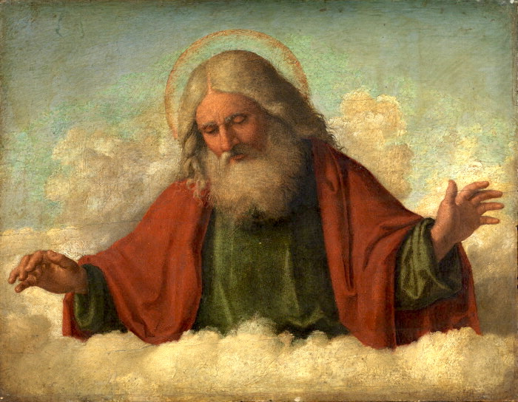
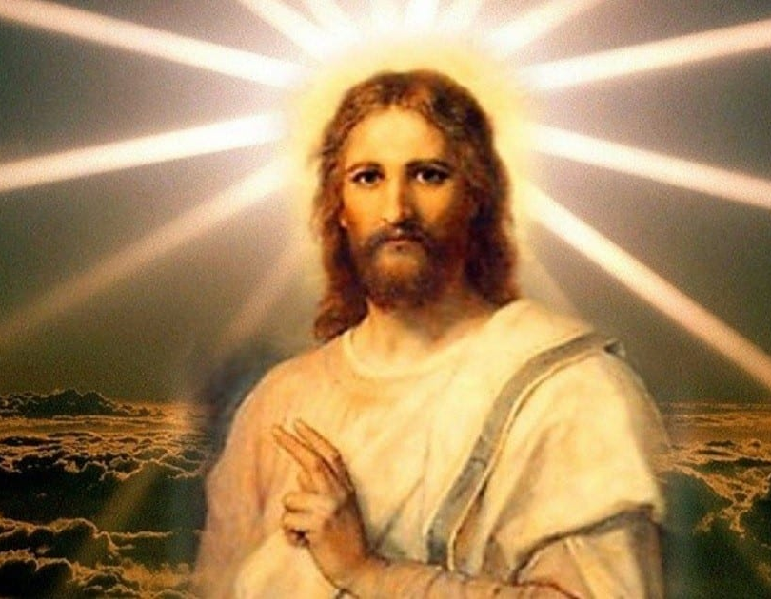
Divine Familial Terms Definition
God is the Father
Jesus is the Son
Father
Trinity
Son
Holy Spirit

Slide 3
?
What are some names or titles the Bible uses for Jesus?

Slide 4
For the law was given through Moses, but grace and truth came through Jesus Christ.
He first found his own brother Simon, and said to him, “We have found the ^{[l]}Messiah” (which is translated, the Christ).
But that you may know that the Son of Man has power on earth to forgive sins”—then He said to the paralytic, “Arise, take up your bed, and go to your house.”
Then those who were in the boat came and worshiped Him, saying, “Truly You are the Son of God.”
John 1:17
John 1:41
Matthew 9:6
Matthew 14:33

Slide 5
?
What are some names or titles the Bible uses for God?

Slide 6
Let your light so shine before men, that they may see your good works and glorify your Father in heaven.
When Abram was ninety-nine years old, the Lord appeared to Abram and said to him, “I am Almighty God; walk before Me and be blameless.
This is the history of the heavens and the earth when they were created, in the day that the Lord God made the earth and the heavens,
Matthew 5:16
Genesis 17:1
Genesis 2:4

Slide 7
?
What are some names or titles the Bible uses for the Holy Spirit?

Slide 8
And I will pray the Father, and He will give you another Helper, that He may abide with you forever—
When He had been baptized, Jesus came up immediately from the water; and behold, the heavens were opened to Him, and ^{[a]}He saw the Spirit of God descending like a dove and alighting upon Him.
However, when He, the Spirit of truth, has come, He will guide you into all truth; for He will not speak on His own authority, but whatever He hears He will speak; and He will tell you things to come.
John 14:16
Matthew 3:16
John 16:13

Slide 9
?
Who chose these terms?
Why is it important?

Slide 10

As defined in God’s Word
God is the Father
Jesus is the Son

Slide 11
Some translators have done this differently
God’s chosen one
or
Beloved One
Son of God
Master
or
Most High
God the Father

Slide 12
?
What meaning might be lost if we change these?
Relationship
Significance
Eternal nature
Trinity

Slide 13
1 John 4:14
How God communicated this verse:
The Father has sent the Son to be the Savior of the world.
1
The same verse without Father and Son:
The Master has sent the Beloved One to be the Savior of the world.
2
What is now unclear?
Savior = God
God’s great sacrifice

Slide 14
John 5:17–18
How God communicated these verses (Jesus is speaking):
“My Father is working even now and I, too, am working.” Because of this, the Jews sought even more to kill him because he not only broke the Sabbath, but also called God his own Father, making himself equal with God.
1
The same verses without Father:
“My Master is working even now and I, too, am working.” Because of this, the Jews sought even more to kill him because he not only broke the Sabbath, but also called God his own Master, making himself equal with God.
2
What is now unclear?
“Equal with God”

Slide 15

Other Scriptural Examples
John 10:30–31
John 10:33, 36
Hebrews 1:8
John 3:16

Slide 16
Bible Translation
Terms for God the Father and Jesus the Son should be:
Accurate
Literal
Common language

Slide 17
1 Corinthians 2:13
These things we also speak, not in words which man’s wisdom teaches but which the Holy Spirit teaches, comparing spiritual things with spiritual.

Slide 18

bibleineverylanguage.org -> “Translations”

Slide 19
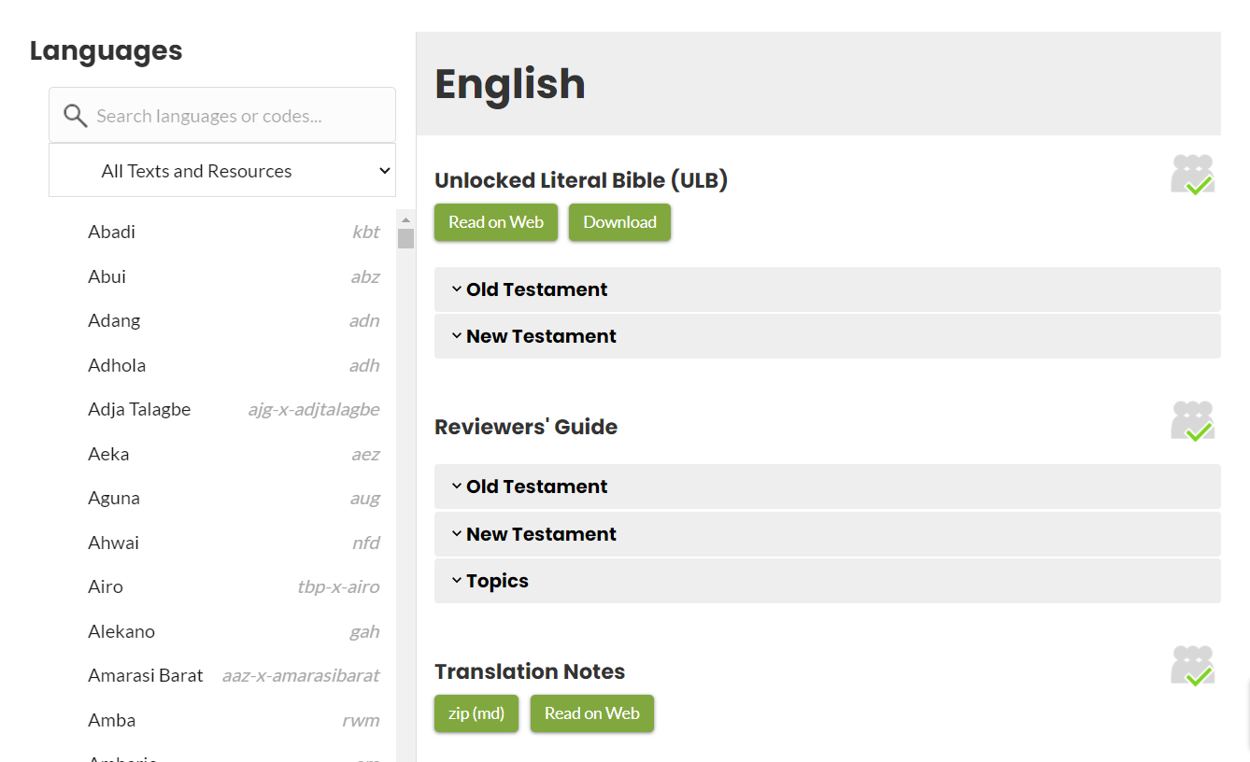
Select language. Under “Reviewers’ Guides”, expand the “Topics” heading.

Slide 20
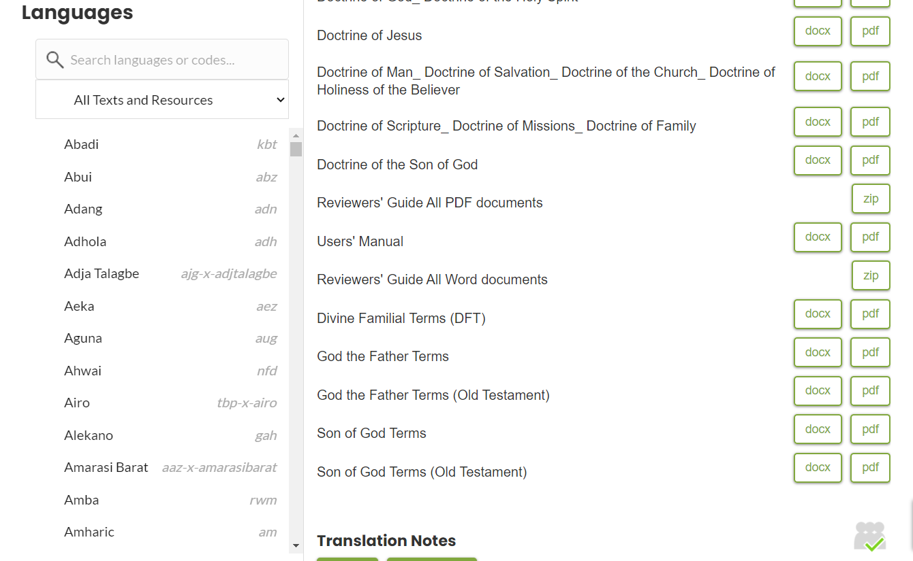
Select the document and the format you need.

Slide 21
Different meanings for the word “father”
The word “father” has several meanings in the New Testament.
1. Biological, male parent
2. Ancestor
3. Someone older
4. Spiritual father
5. Source of a characteristic
6. God the Father of his people
7. God the Father of Jesus

Slide 22
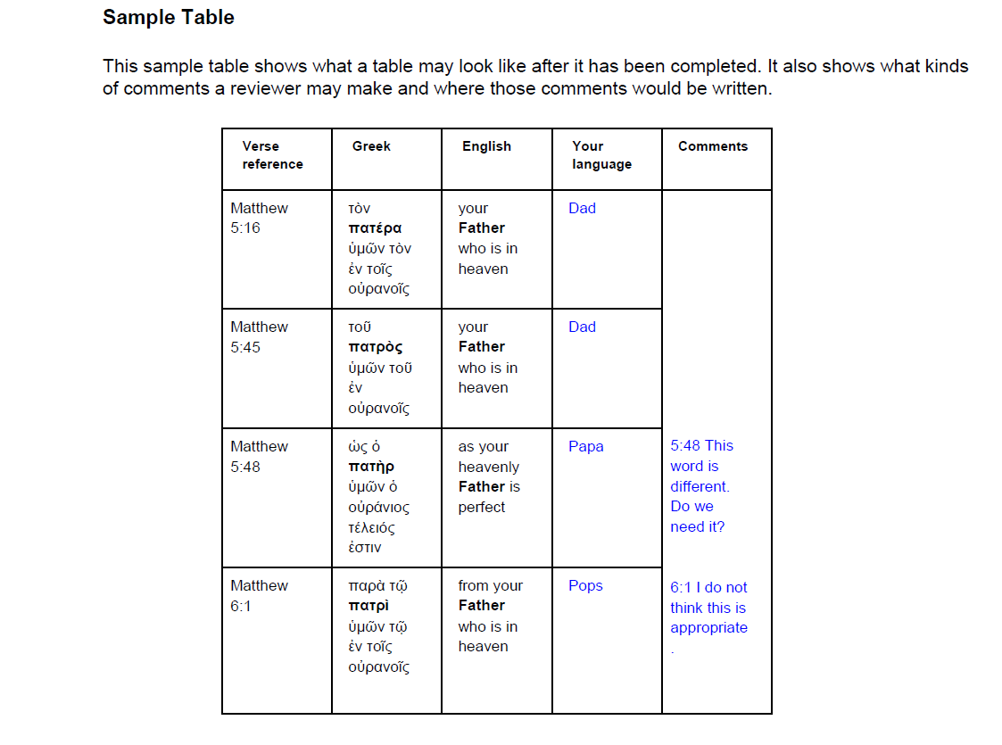
God the Father Terms p. 6

